Slide 1

Green University of Bangladesh Department of Computer Science and Engineering(CSE)
Faculty of Sciences and Engineering Semester: (Fall , Year:2022), B.Sc. in CSE (Day)
LAB REPORT NO : 1
Course Title : Structured Programming Lab
Section : DC
Course Code : CSE 104
Student Details
Name | ID
Md. Sohan Millat Sakib | 222902036
: 18-10-2022
Lab Date Submission Date : 25-10-22 Course Teacher’s Name
: JARIN TASNIM TONVI
[For Teachers use only: Don’t Write Anything inside this box]
Marks:.....
Comments:
Lab Report Status
Signature: Date:.........

Slide 2
Introduction to C
C is a general-purpose structured programming language which is developed by Dennis Ritchie in Bell Labretory in 1972.It is most popular language for beginer because it is middle level language. C is developed using linux operating system but the interesting thing is that in the later time Linux kernel was developed by C language.. The advantage of C programming language is very fast than any other language.
Problem 1:
Title: Write a C Program to display your Id, Name, Dept. Name and University Name followed by a newline.
Objectives:
To be familiar with scanf,printf, and fflush function
Learn to solve the problem with arithmetic expressions.
Input & Output:
At first we have to read 4 data such as Id, Name, Dept. Name and University Name..Then print these value...

Slide 3
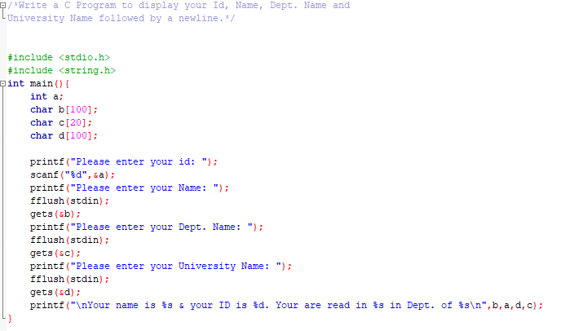
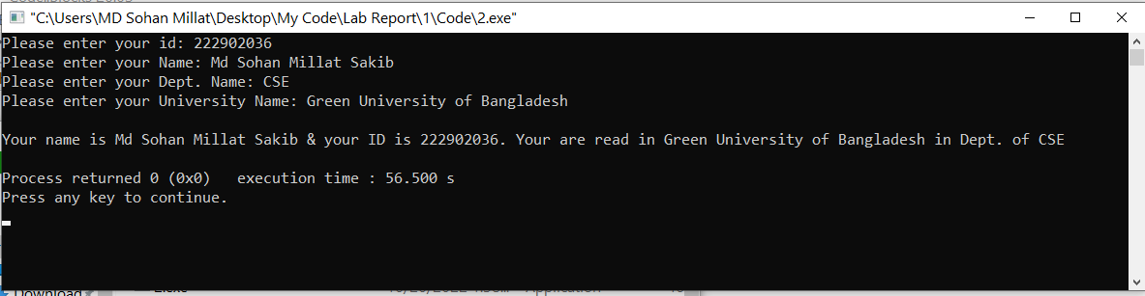
Implementation:
Test Result:
Discussion: When I run the code I face a problem because of use the scanf() functin before gets() function. For solve this problem I use fflush(stdin) function for flash memory buffer.

Slide 4
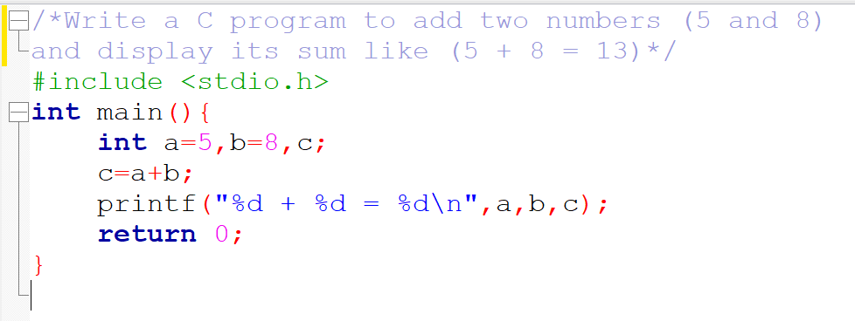
Problem 2:
Title: Write a C program to add two numbers (5 and 8) and display its sum like (5 + 8 = 13)
Objectives:
To be familiar with scanf,printf function & variable.
Learn to solve the problem with arithmetic expressions.
Input & Output:
At first, we have to take 3 variables. Assign 5 on a & 8 on b. Then calculate the summission of a & b. Then print it.
Implementation:

Slide 5
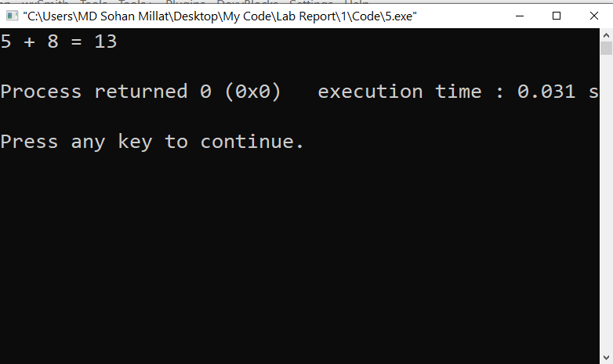
Test Result:
Discussion: I think this is a simple problem and I didn’t face any problem to solve this.
Problem 3:
Title: Write a C Program to input two numbers as input and display its product.
Objectives:
To be familiar with scanf,printf function & variable.
Learn to solve the problem with arithmetic expressions.
C is a case sensitive language. So we have to remind it. All the keyword of the c programme is lower case.
Input & Output:
At first, we have to take 3 variables. Now read two value from user. Then calculate the product of a & b. Then print it.

Slide 6
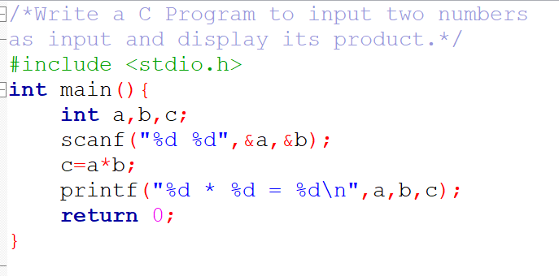
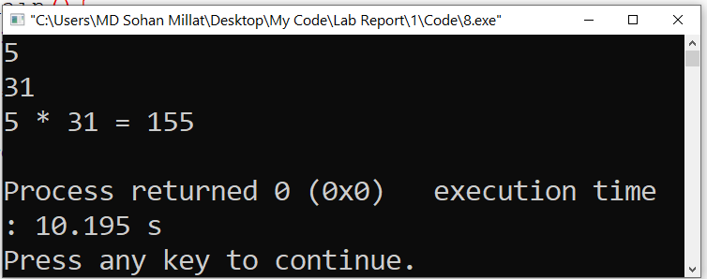
Implementation:
Test Result:
Discussion: I don’t face any problem to solve this….

Slide 7
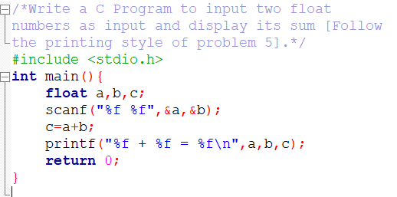
Problem 4:
Title: Write a C Program to input two numbers as input and display its product.
Objectives:
To be familiar with scanf,printf function & variable.
Learn to solve the problem with arithmetic expressions.
C is a case sensitive language. So we have to remind it. All the keyword of the c programme is lower case.
Input & Output:
At first, we have to take 3 floating point variables. Now read two value from user. Then calculate the sum of a & b. Then print it.
Implementation:

Slide 8
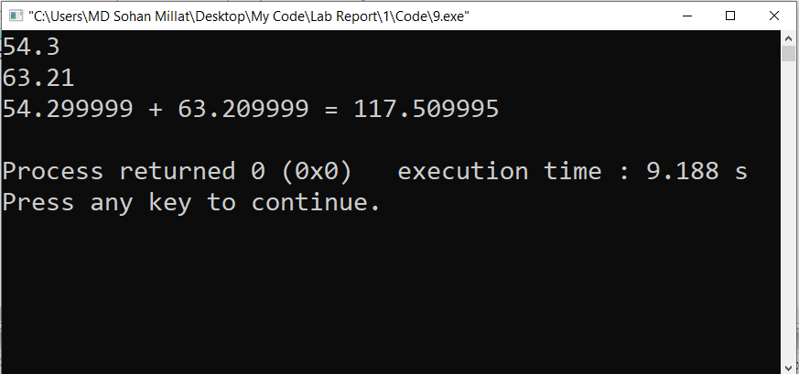
Test Result:
Discussion: Here I face a problem. At first I input a floating point value and the value is 54.3 and in the variable store this as 54.299999. Which is not equal exactly. From Internet resource I can know that if I want to input the value accurately I have use double type variable.

